Slide 1
Intelligent Control (ECE5759) Final Term Project
Object Detection in Aerial Images

Slide 2
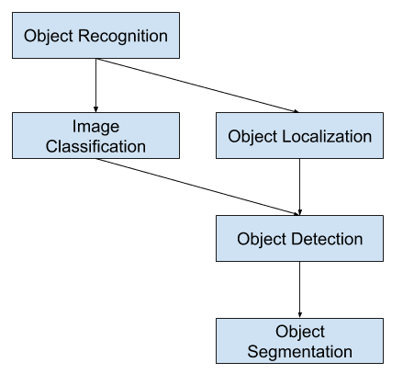
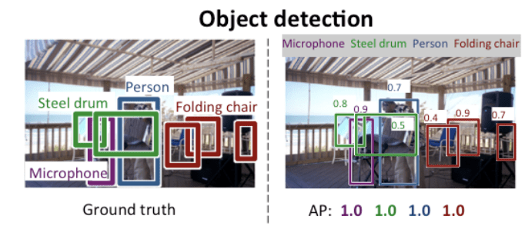
Object Detection
Object Detection:
Object detection is the task of detecting instances of objects of a certain class within an image.
Each detected objects are usually marked with a bounding boxes along with a confidence score and a class ID.

Slide 3
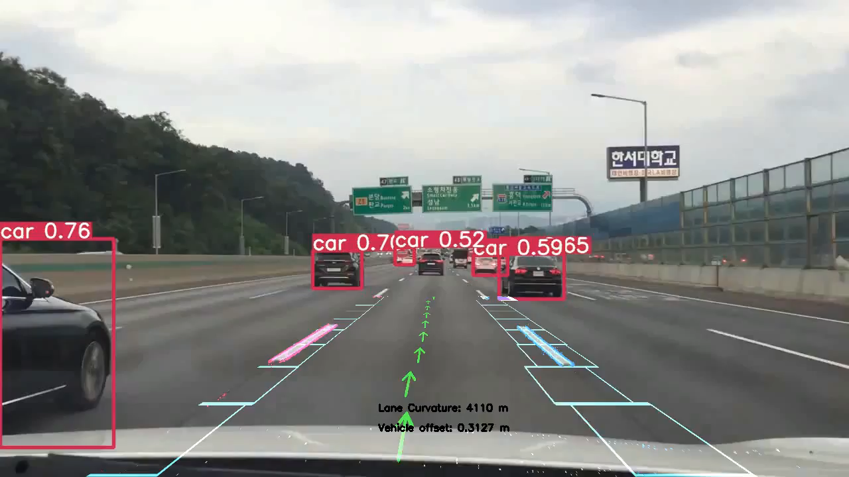
Object Detection
Demo:

Slide 4
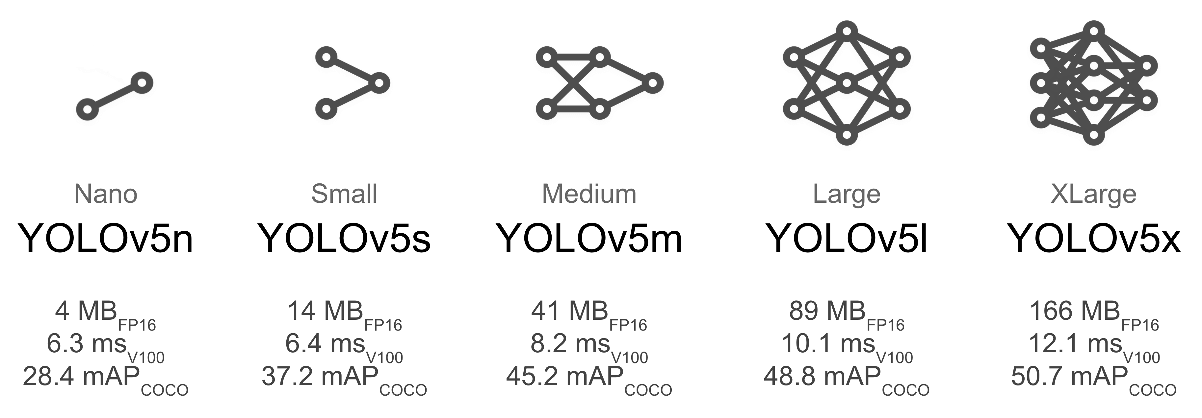
Overview
YOLOv5:
YOLOv5 is a family of object detection architectures and models that is famous for its robust performance and high throughput.

Slide 5
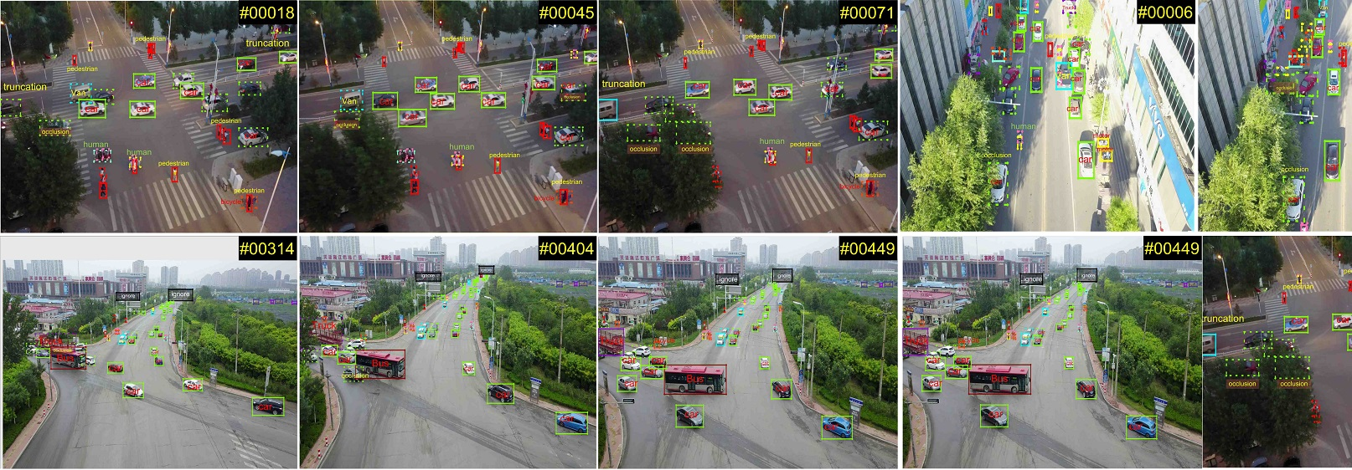
Overview
VisDrone dataset:
Drones, or general UAVs, equipped with cameras have been fast deployed to a wide range of applications, including agricultural, aerial photography, fast delivery, and surveillance.
Automatic understanding of visual data collected from these platforms become highly demanding, which brings computer vision to drones more and more closely.

Slide 6
Tasks & Goals
Tasks:
In this homework, you will learn how to use YOLO object detection models on real-world surveillance datasets.
Your job is to perform training and testing YOLOv5 models on the given VisDrone dataset.
The model, data, training, and testing pipelines have been provided.
You can adjust some parameters to make the training faster or to obtain higher accuracy.

Slide 7
Tasks & Goals
Goals:
You must try to train and obtain the highest accuracy on the VisDrone dataset.
You must make prepare a submission file of the test-set:
Run prediction scripts in the Jupyter Notebook and obtain the results (.txt file) for each image.
Compress everything to a single zip file and rename it to: student_id.zip
In the end, we will select the best result among all trials of each student.
How to submit:
Submission link: https://codalab.lisn.upsaclay.fr/competitions/4806
Register using school email account (No exception)
Max total submissions: 100
Max submissions per day: 10
Deadline: 11:59 PM on May 30, 2022

Slide 8
Getting Started
Prerequisite:
OS: Ubuntu 20.04 / 22.04
Environment: Python>=3.9.0 and PyTorch>=1.11.0 with anaconda (Recommend)
Editor: Jupyter Notebook
Link:
Go to the Github repo and follow the instruction there.
https://github.com/SKKU-AutoLab-VSW/ece5759_homework

